Slide 1
GameLoft Internship Project “Escape the Centegeon”
Nguyen Quang Phuc
[HIN018]

Slide 2
Table of contents
I. Introduction
II. Game Elements
1. Core Gameplay
2. Game Mechanics
3. Menu Components
III Game Development
1. Game Design Principles
2 Game Programming
IV. Miscellaneous
Q&A

Slide 3
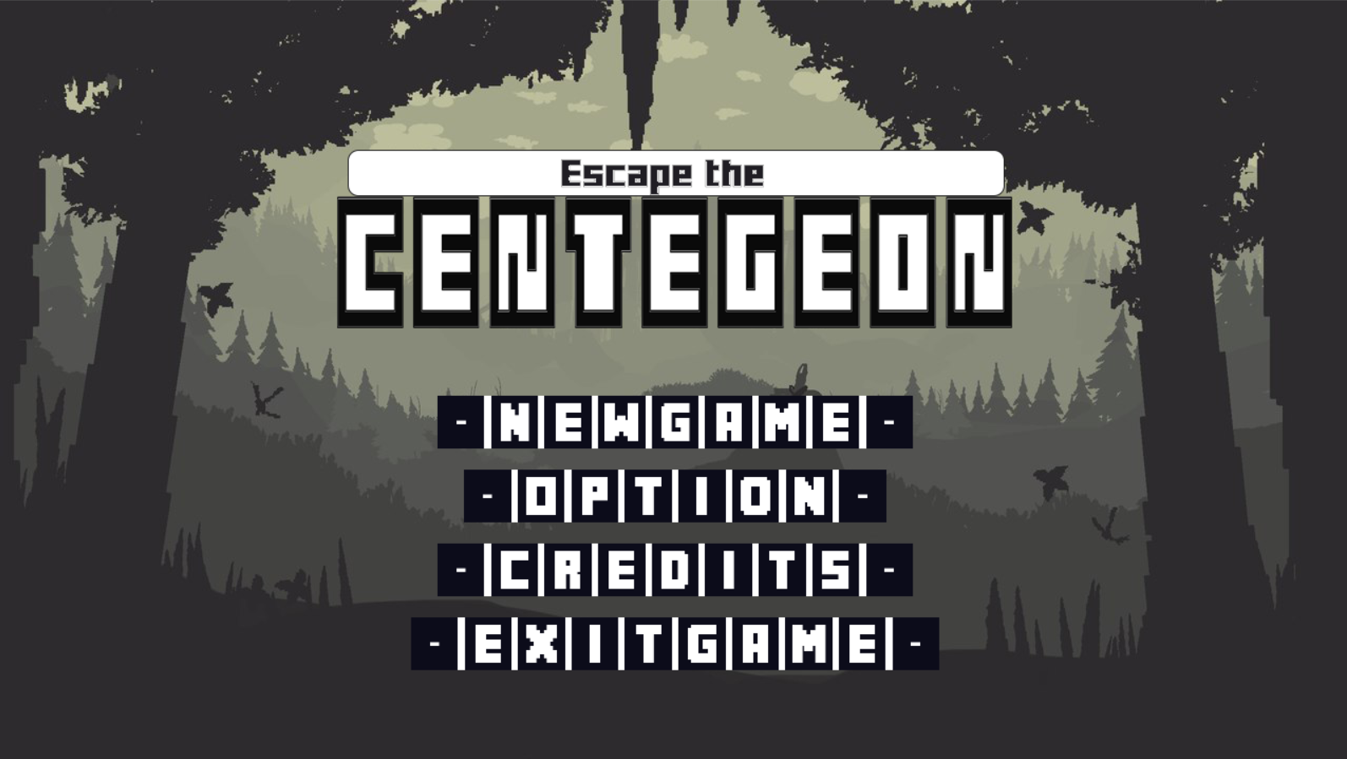
I. Introduction

Slide 4
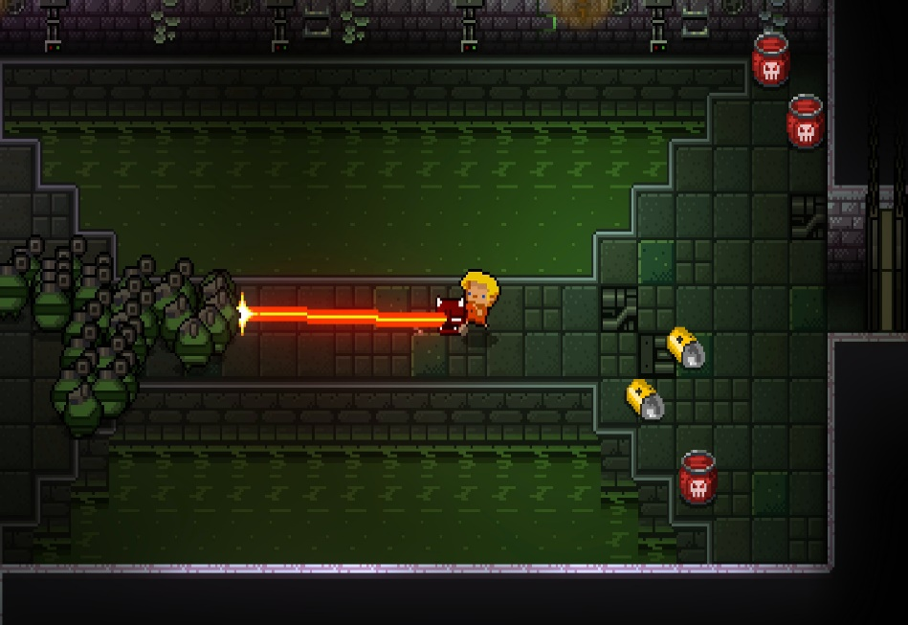
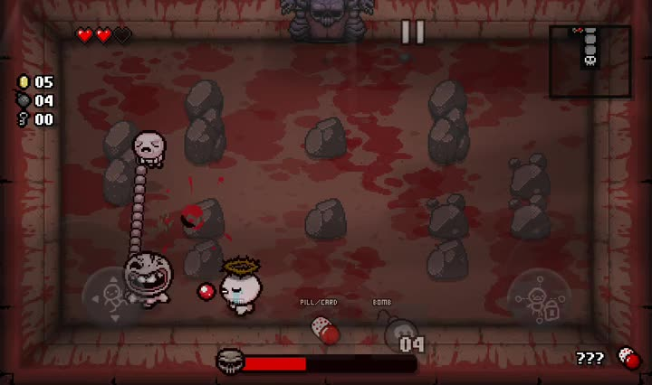
I. Introduction
Project Code: “Centegon”
Game Title : Escape the Centegeon
Genre : Roguelike, Beat’em up, 2D Top-Down
Inspiration :
+ Enter the Gungeon
+ The Binding Of Isaac : Rebirth

Slide 5
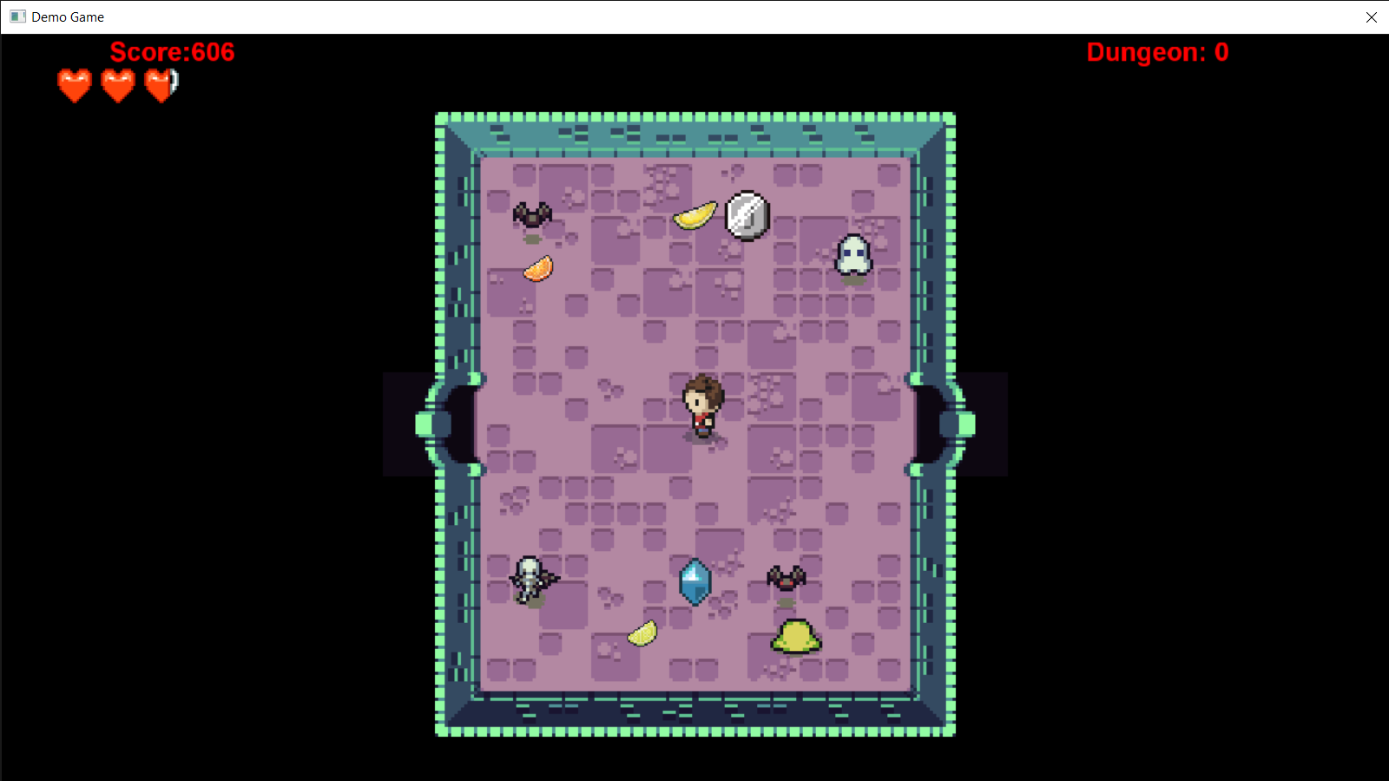
II. Game Elements
1. Core Gameplay
Control a character to explore rooms and fight monster with his sword in random generated dungeons
Player can move freely in 4 direction, slash enemies , collect item.

Slide 6
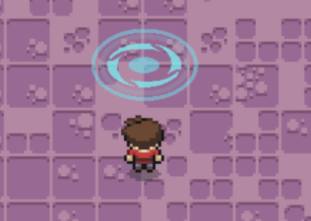
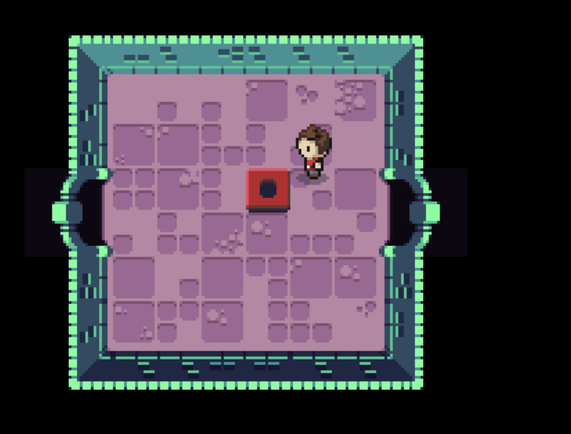
II. Game Elements
1. Core Gameplay
A Dungeon is consisted of multiple rooms
There is an “endpoint” room, which contains a warp to the next dungeon.
To access to this room, you need to enable a switch, placed randomly in a random room.

Slide 7
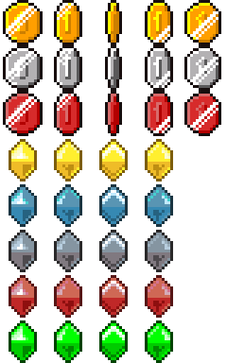
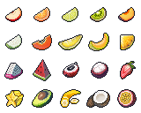




II. Gameplay
2. Game Mechanics
Item:
- Fruits: restore Hearts.
- Coins : add Score points.
- Each type has different amount of effect
Enemy:
- Can detect player when in range and find path to come to hit player.

Slide 8
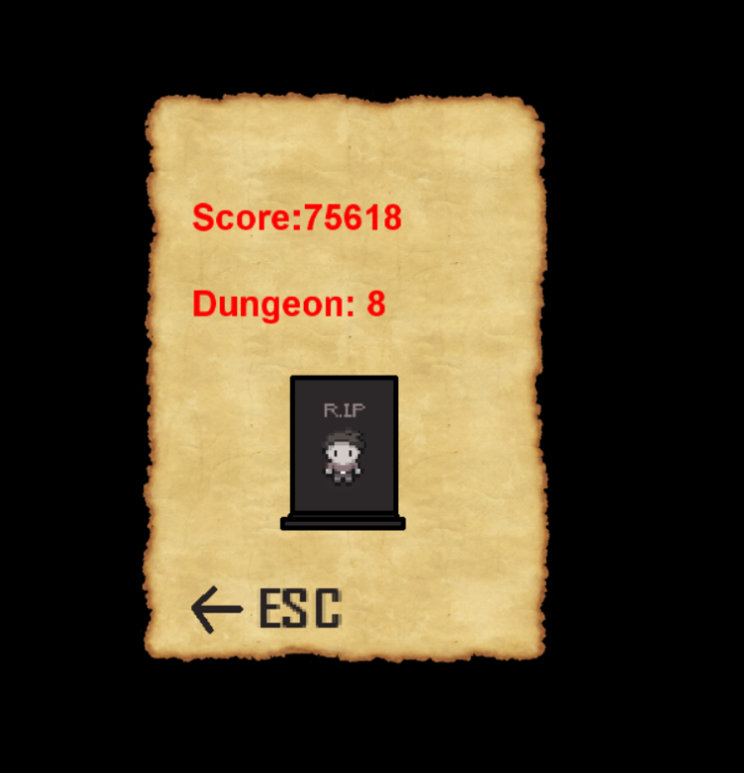
II. Gameplay
2. Game Mechanics
Score Mechanics:
There are 2 type of score :
- Score Point : Gained by vanquishing enemies or collecting coins.
- Dungeon Count : Gained by completing a dungeon.
Permanent Death :
When player’s hearts are all empty, he is dead, and you can only return to main menu

Slide 9
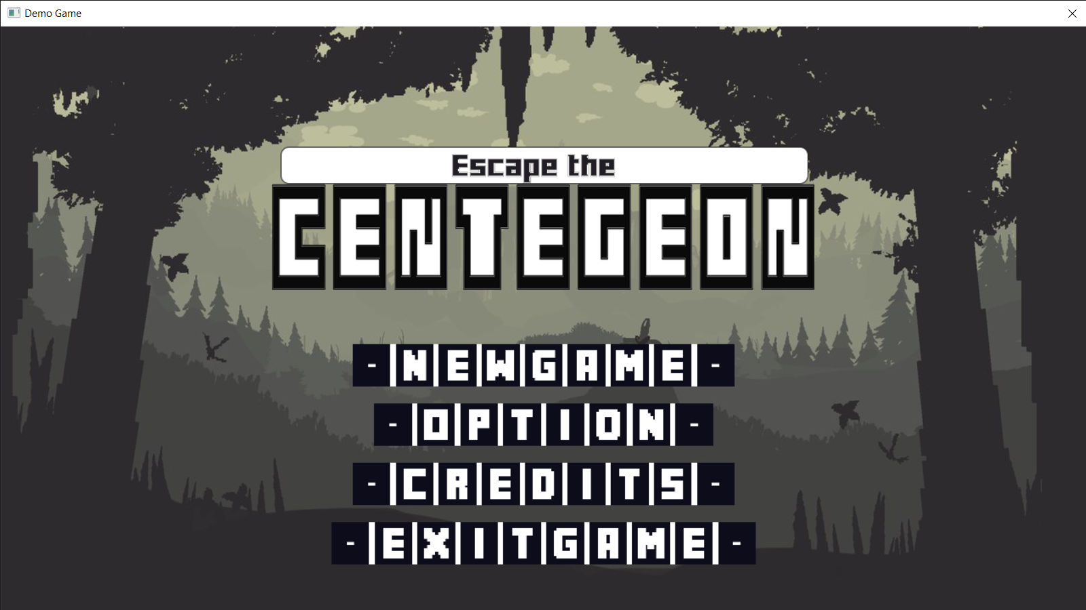
II. Gameplay
3. Menu Components

Slide 10
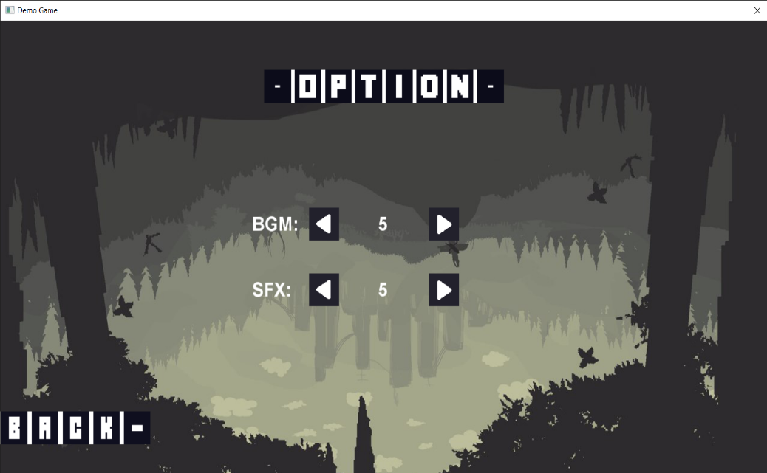
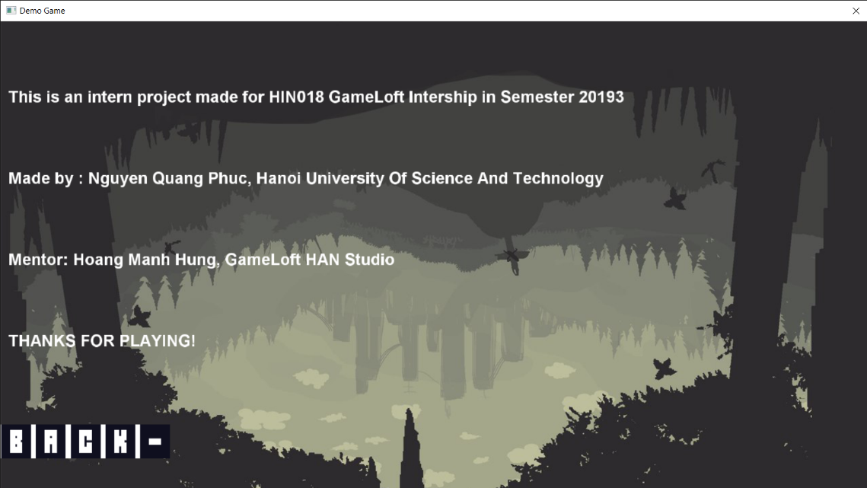
II. Gameplay
3. Menu Components

Slide 11

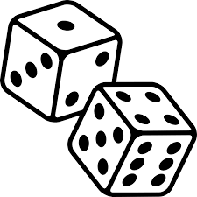
III. Game Development
Game Design Principles
Randomness
Exploration

Slide 12
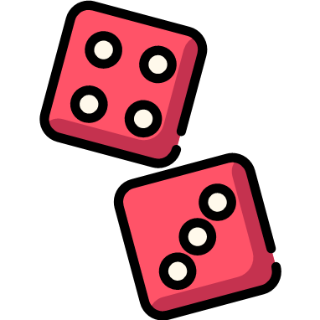

III. Game Development
Game Design Principles
- “Everything is randomized”:
+ Dungeons
+ Room
+ Item/Enemy Parameters
+ Music
etc.
- Random stuffs make the game always new in every game session.
No minimap.
Regenerated items and enemies.
Randomization

Slide 13
III. Game Development
2. Game Programming
Random Generated Dungeon Algorithm ( RGDA)
Dungeon:
+ Rooms’ position in dungeon is randomly generated, so that they are all connected.
+ After having a map of rooms, randomly choose a room suitable to be an “endpoint” room and a room to place a switch.
Room : Items and enemies' position is randomized.
Item : When initializing, sprite and amount of points gained/ heart restored are randomly chosen;
Enemy: Parameters like walking speed, range of detection are random in a range.

Slide 14
III. Game Development
2. Game Programming
Enemy AI
+ Enemy actions are random when player is out of range.
+ When player is in range, using a heuristic search algorithm to decide how to approach player.
Data Reading
+ tinyxml.
+ Basic information about animations, enemies, items is stored in xml files.
+ Read the data when initialize new game.

Slide 15
IV. Miscellaneous
Difficulty in development:
+ Optimization.
+ Algorithms.
+ Time .
Future Work:
+ Add more features : Player Attack Skills, Boss Rooms, High Score, etc.
+ Improve algorithms : Make randomization more attractive and complex, Enemy AI,…
+ Create Multiplayer Mode.

Slide 16


Slide 17


